Slide 1
Children & Youth and Engaging Men
New Grantee Orientation
JustGrants Support Session
December 10, 2024

Slide 2
Agenda
User Roles
Assigning Roles to Awards
My Worklist
Read Only vs. Edit Mode
Deliverables
To GAM or Not to GAM
Troubleshooting
When to Call Help Desk

Slide 3
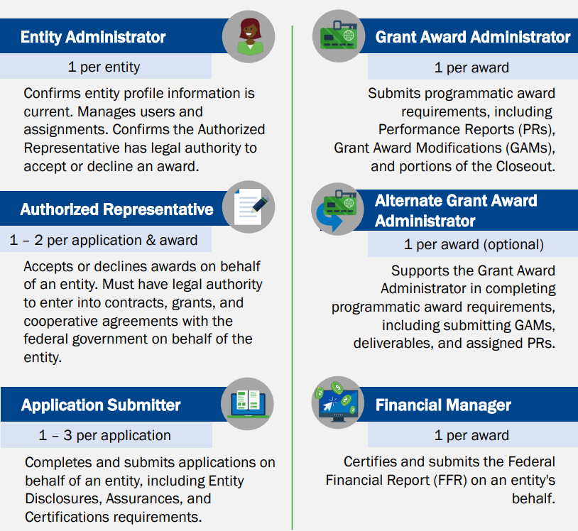
User Roles
There are six (6) roles in JustGrants, each with unique duties and abilities. An entity user can be assigned multiple JustGrants roles.

Slide 4
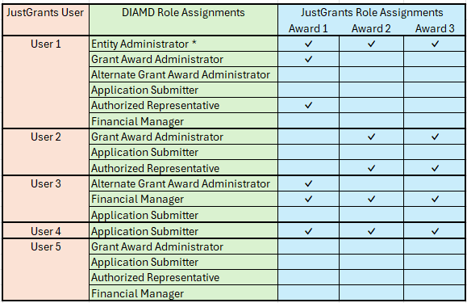
User Roles – Example
This sample Entity has multiple users and awards. Some users have multiple roles assigned to multiple awards.

Slide 5
Assigning Roles to Awards
Adding Roles in DIAMD
The Entity Administrator is the only role with the ability to assign (and unassign) roles and awards to users.
Assigning users to a particular award or application is a 2-step process.
Ensure that user has the correct role assigned in DIAMD
Assign the user to the award in JustGrants
To verify the user’s roles, the Entity Administrator will do the following.
From the JustGrants Home page, click the Entity Users link from the left side of the screen
The users will be displayed with the current roles assigned to them
If the needed role is assigned to the user, you can proceed with assigning the award to that user (next slide)
If the needed role is not assigned to the user, you must add that role in DIAMD – Click Manage Users button on the top of the page to access DIAMD
Click on the DIAMD tile to launch the Entity Management services
Click Manage Member tile
Search for User by First Name, Last Name, or Email Address
Select Roles to Add (or Remove) from the dropdowns and click Next
Review the requested modifications and click Confirm to proceed
The above steps and additional information can be found in the Entity Management Job Aid Reference Guide, pages 47-51:
https://justicegrants.usdoj.gov/training/jarg-entity-management.pdf

Slide 6
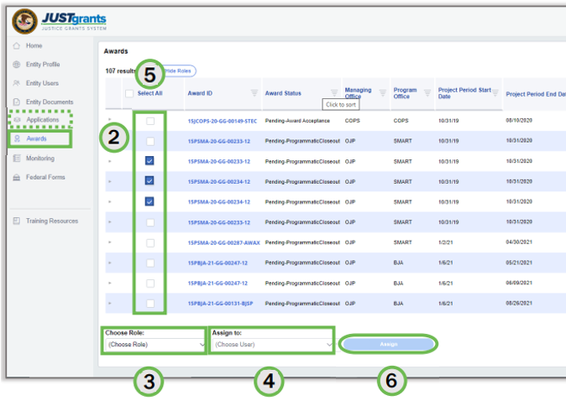
Assigning Roles to Awards
Assigning the User to the Award in JustGrants
Once the user has the required role assigned to them, the Entity Administrator can assign the award to the user by doing the following.
To reassign awards to a user,
Open the JustGrants Landing Page
Select Awards (or Applications) from the navigation bar on the left side of the screen
Select the Choose Role dropdown menu to select the role to reassign
Select the Assign to dropdown Menu to select the user to reassign
Select the checkboxes next to the awards to be reassigned
Select Assign to complete the action
Select Submit on the confirmation page
The above steps and additional information can be found in the Entity Management Job Aid Reference Guide, pages 78-87:
https://justicegrants.usdoj.gov/training/jarg-entity-management.pdf

Slide 7
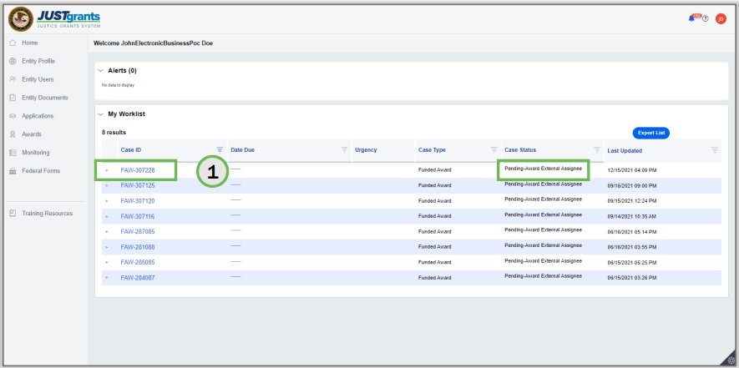
My Worklist
Each user’s My Worklist is located on the JustGrants Home screen. It displays tasks based on the user's designated roles, application, and award assignments.
What will show up on your worklist?
Pending / Change requested
Performance Reports
Pending Financial Reports
Pending Award Acceptances
Pending Application Submission
Pending Closeouts
Change requested GAMs
Change requested Deliverables

Slide 8
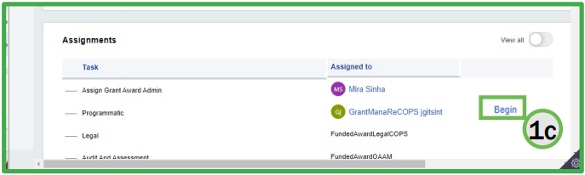

Read Only vs. Edit Mode
When accessing your awards, you are defaulted to a Read Only mode. You cannot take any actions (e.g. create GAM, submit Deliverable, etc.) until you are in an Edit Mode.
If you access any work item from your Worklist, you go directly to Edit Mode.
The Grant Award Administrator (or Alternate Grant Award Administrator) can go to Edit Mode by completing the following:
From the JustGrants Homepage, Click Awards
Click the Award for which you want to access in Edit Mode
In Assignments section, Click Begin button that corresponds to Programmatic

Slide 9
Deliverables
Award Deliverables are documents that recipients must submit for review and approval per conditions of their award or the project's goals and objectives. Examples of Award Deliverables are items for dissemination such as publications, communications, and curricula.
The Grant Award Administrator (or Alternate Grant Award Administrator) can submit an Award Deliverable by doing the following.
From the home page, select Awards
Select the Award ID for the award you wish to open
Select Begin next to the Programmatic Task to open the award in Edit Mode
Select the Performance Management tab in the Funded Award
Under Award Deliverables, select Add Attachment
Use the Select file(s) button to attach file(s)
Select the file category from the dropdown and add comments as needed.
Click Attach
The above steps and additional information can be found in Managing Award Deliverables, pages 4-7: https://justicegrants.usdoj.gov/training/training-performance-reporting/managing-award-deliverables.pdf

Slide 10
To GAM or Not to GAM
There are 3 different types of Grant Award Modifications (GAMs).
Project Period Extension | Programmatic | Financial
Project Period Extension GAM | Programmatic Cost GAM Scope Change GAM | Budget Modification GAM Sole Source GAM Budget Clearance GAM*
The following actions can still be done in JustGrants but are not being treated as GAMs:
Within JustGrants, an Entity Administrator can change the Grant Award Administrator and Change the Authorized Representative.
On SAM.gov, grantees can update:
  Entity name
  Address
  E-Biz POC
* The Budget Clearance GAMs are initiated by DOJ.

Slide 11
To GAM or Not to GAM
Creating a GAM
The assigned Grant Award Administrator (or Alternate Grant Award Administrator) can create a GAM by doing the following.
From the JustGrants Homepage, Click Awards
Click the Award ID for which you want to create the GAM
In Assignments section, Click Begin button that corresponds to Programmatic
Click the Grant Award Modification (GAM) tab
Select the GAM type from the Type of Award Change dropdown
If necessary, select the subtype from the Award Change Subtype dropdown
Select Create New GAM
The above steps and additional information can be found in the Grant Award Modification Job Aid Reference Guide, pages 66-72:
https://justicegrants.usdoj.gov/training/jarg-grant-award-modifications.pdf

Slide 12
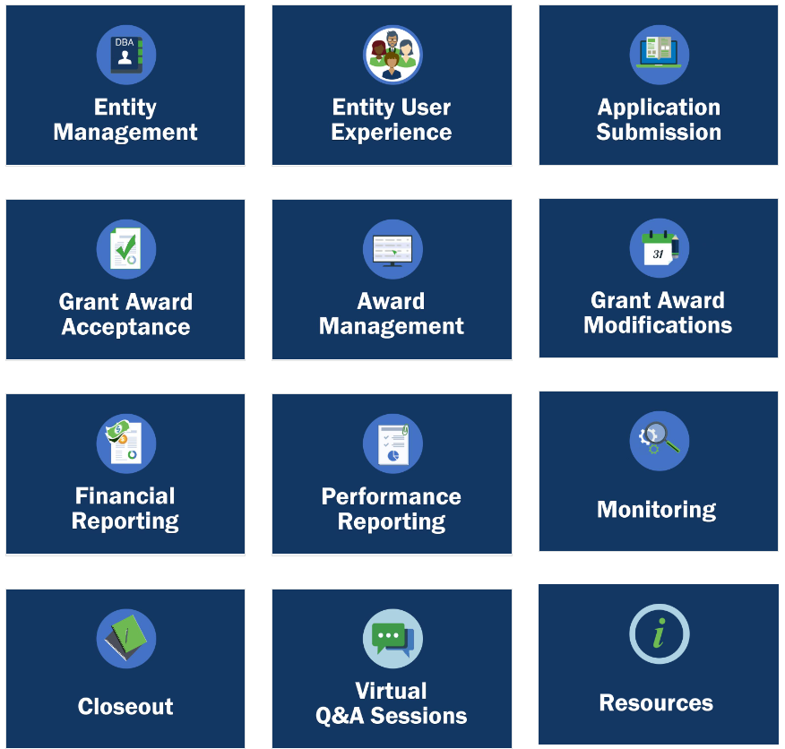
Troubleshooting
If you are having issues with finding or completing a work item, try the following:
Make sure that the user has the correct role and is assigned to the award or application
Unassign and Reassign the user to the award or application
Clear your cache (browser history)
Assign work to someone else and see if they have the desired action available
Review the Training materials located at https://justicegrants.usdoj.gov/training

Slide 13
When to Call the Help Desk
If a user has tried to troubleshoot any issue but still requires technical support with their OVW award or application, they should contact the OVW JustGrants Support Team.
OVW Support OVW.JustGrantsSupport@usdoj.gov 866-655-4482
If an Entity Administrator needs to reset their password, they should contact the OJP JustGrants Support Team.
OJP Support JustGrants.Support@usdoj.gov 833-872-5175
If a user has programmatic questions regarding their OVW award, they should contact their grant management specialist.

